Slide 1


Put it In Action!
Fellas, Time to open Unity

Slide 2
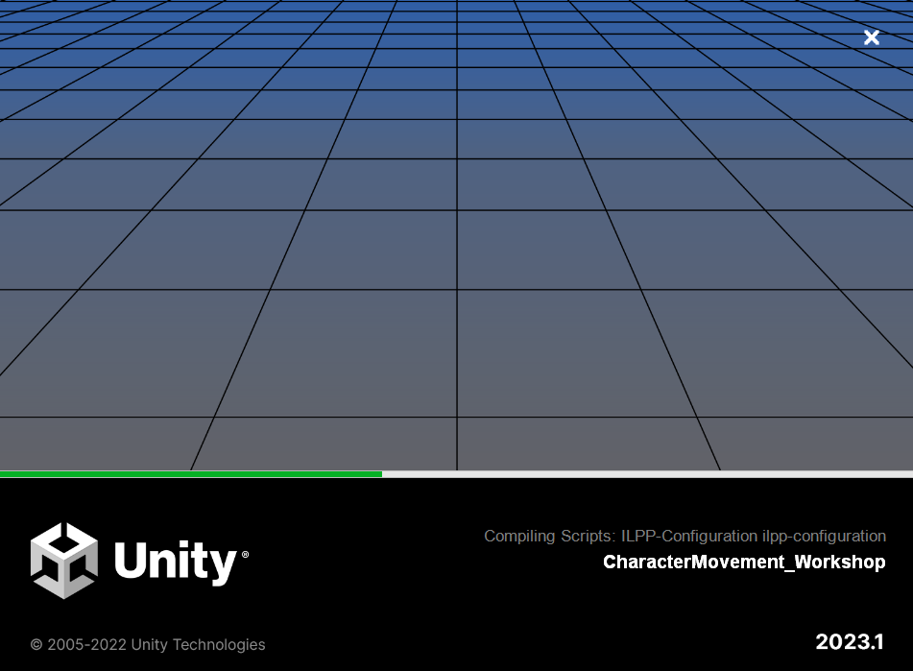

Slide 3
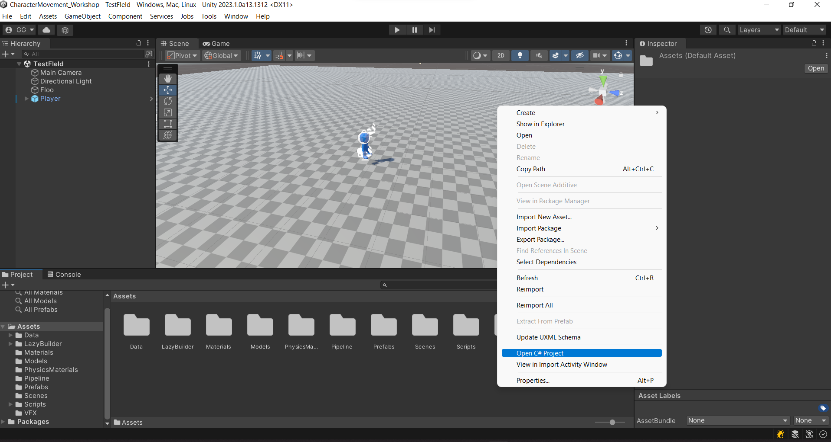

R Click

Slide 4
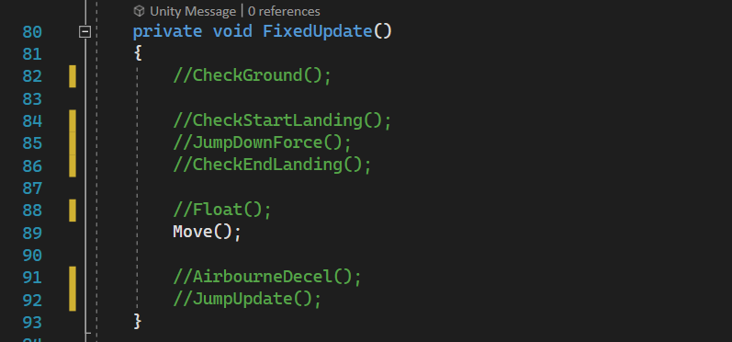
How to Uncomment
Ctrl + K then Ctrl + U

Slide 5
How to Uncomment
Ctrl + K then Ctrl + c

Slide 6

Basics of Unity
For the Complete Rookies

Slide 7
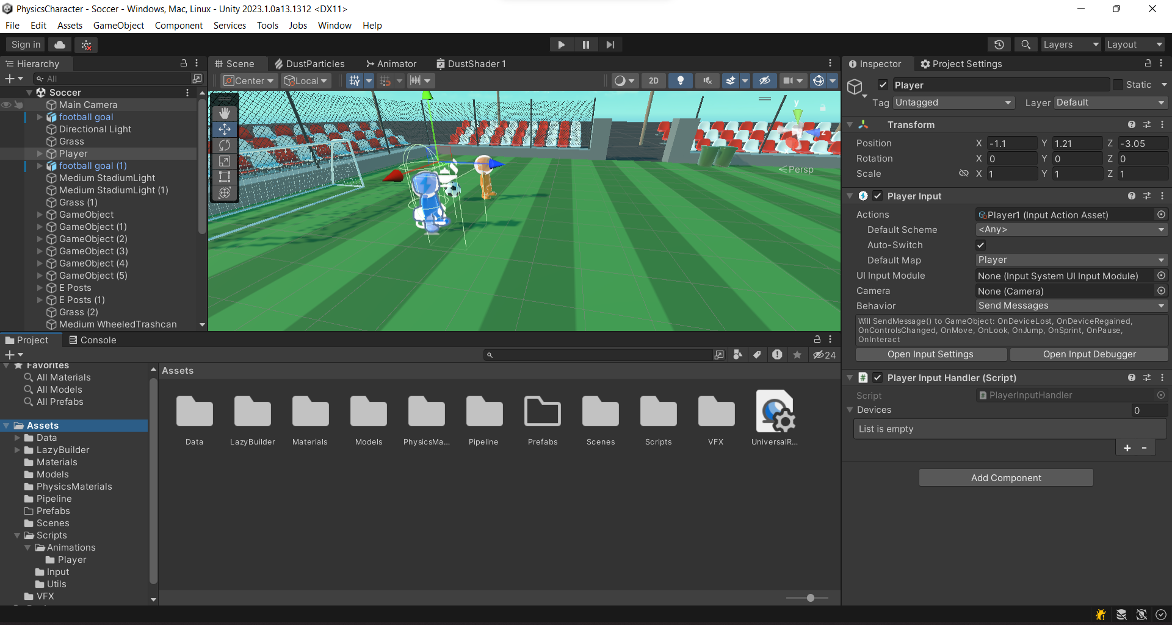

Slide 16
Play Scene
Ctrl + P

Slide 17
Character MOvement
Start

Slide 18
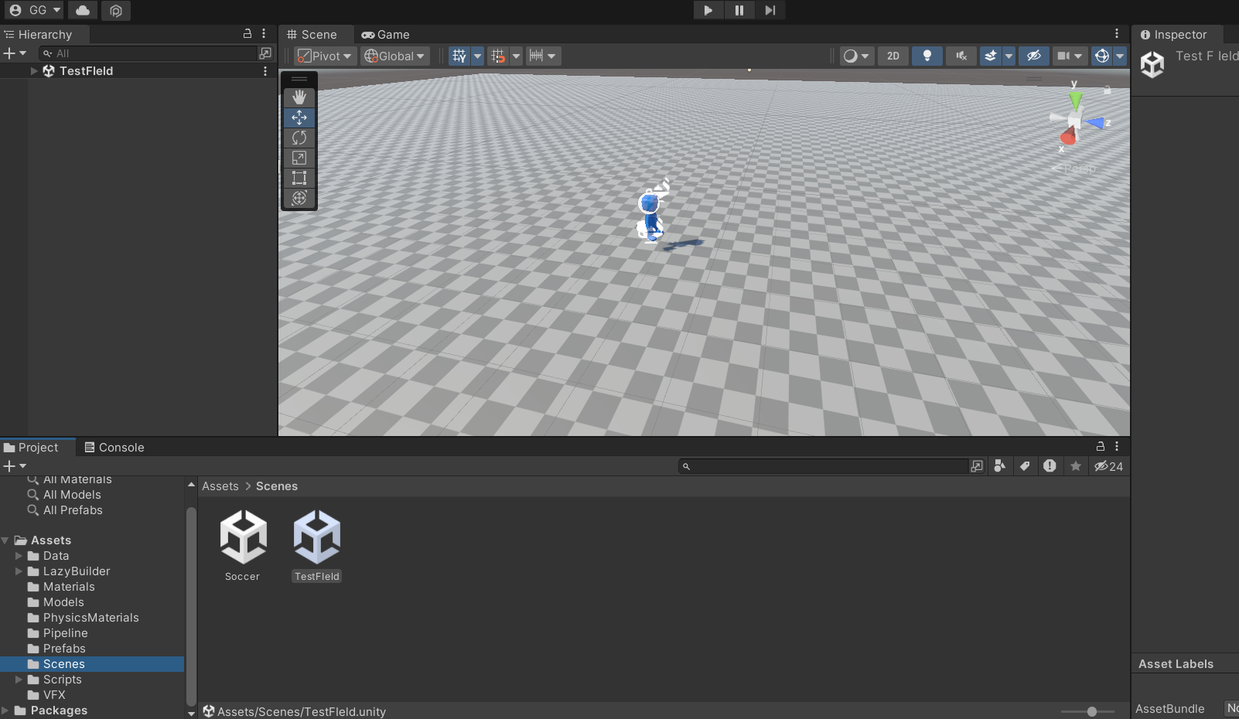

Slide 19
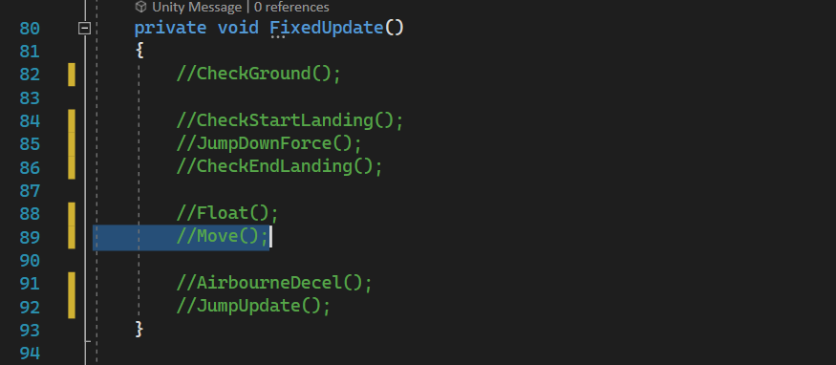

Slide 20
Character MOvement
Checking Ground

Slide 21

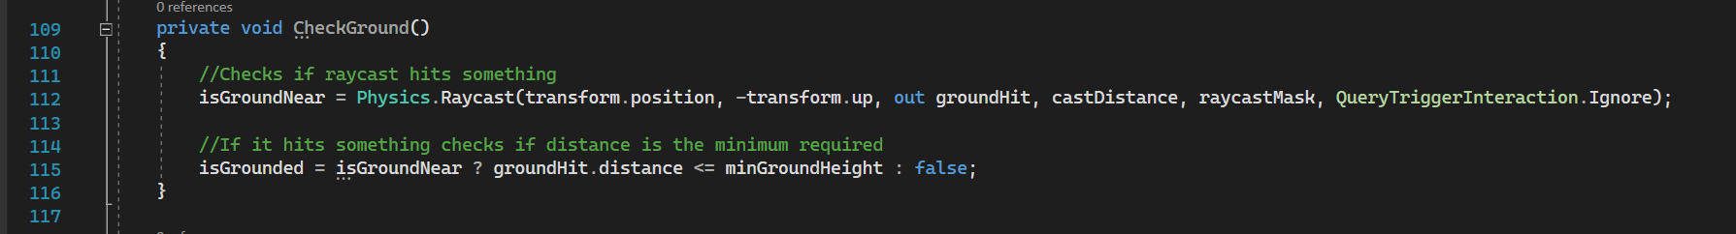

Slide 22
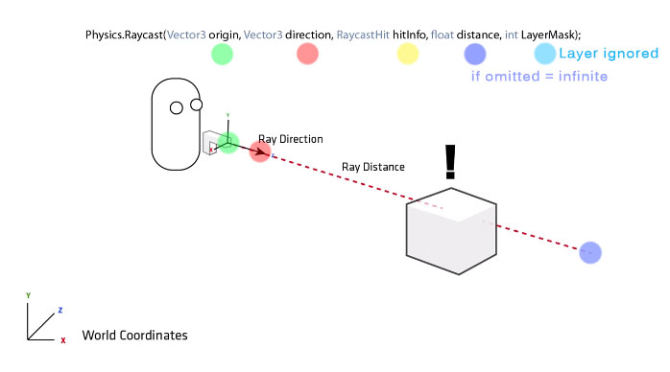

Slide 24
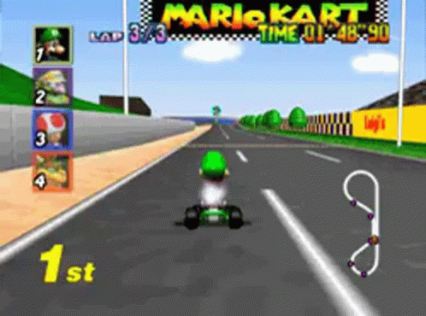
Character MOvement
Floatin

Slide 25
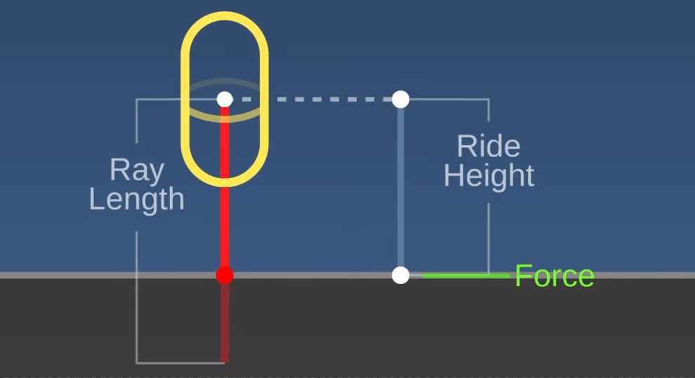
Source: Toyful Games- Youtube

Slide 26
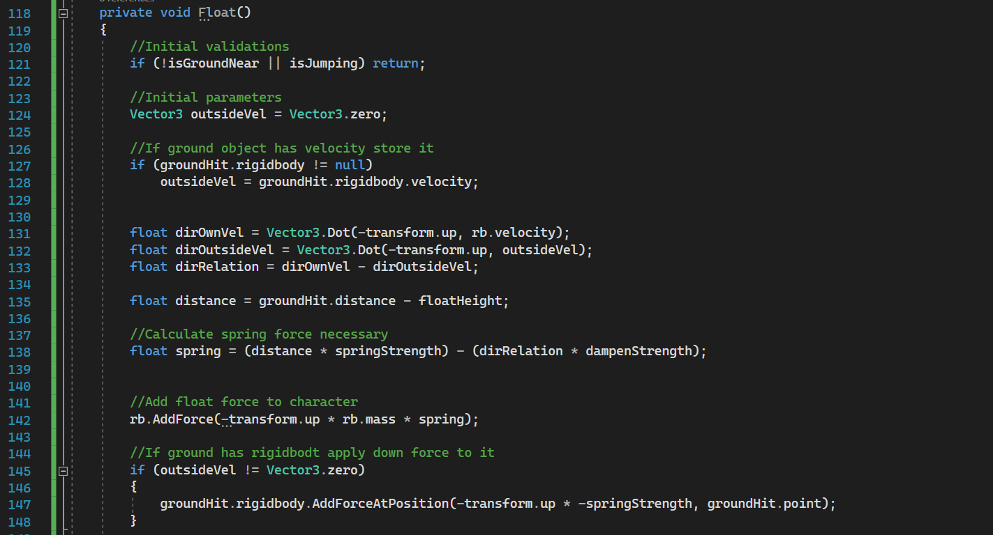
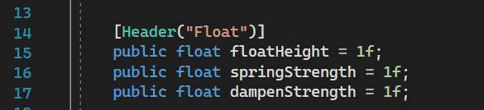
Source: Toyful Games- Youtube

Slide 27
Source: Toyful Games- Youtube

Slide 28
Source: Toyful Games- Youtube

Slide 29
The equation
F = F_{spring} + F_{damping} = (k x)+( − b v)
x = stretch of the spring
k = spring stiffness
v = velocity of the block
b = damping

Slide 30


Spring Factor
Dampen Factor
Source: MyPhysicsLab - Website

Slide 31
Source: Toyful Games- Youtube

Slide 32
Source: Toyful Games- Youtube

Slide 33
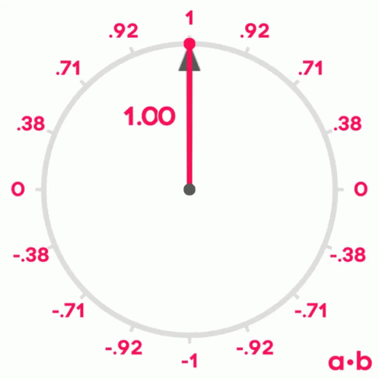
Dot Product

Slide 34
Source: Toyful Games- Youtube

Slide 35
Dotown = 1
DotOTher = -1
vc
DotRel = 1-(-1)=2
vc
vg
vg

Slide 36
Dotown = 1
DotOTher = 1
vc
DotRel = 1-1=0
vc
vg
vg

Slide 37
Dotown = 1
DotOTher = 0
vc
DotRel = 1-0=1
vc
vg
vg

Slide 38
Source: Toyful Games- Youtube

Slide 39
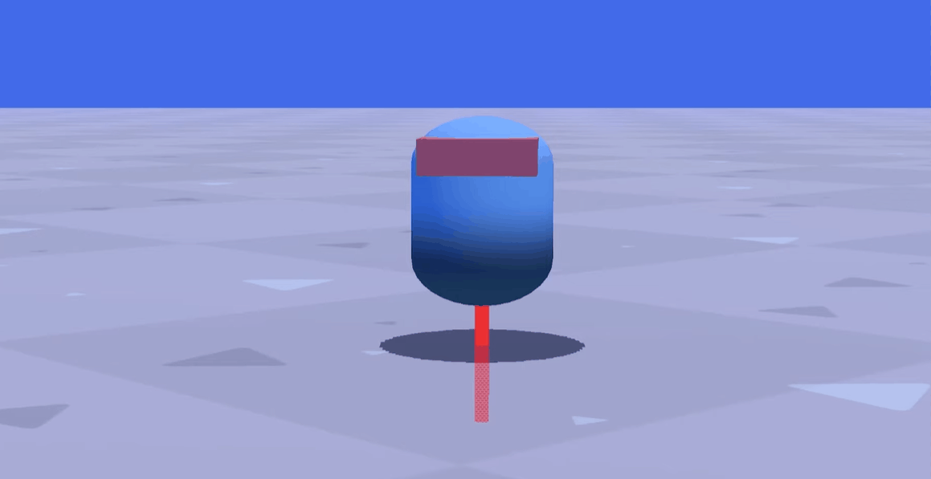
Source: Toyful Games- Youtube

Slide 40
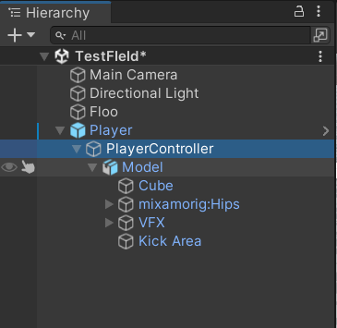
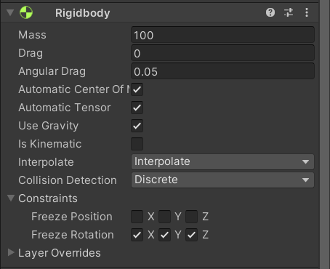

Slide 41
Source: Toyful Games- Youtube

Slide 42
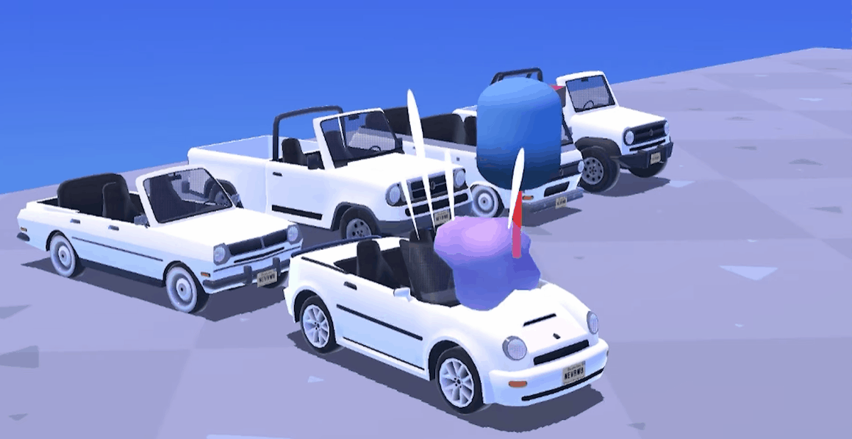
Source: Toyful Games- Youtube

Slide 43

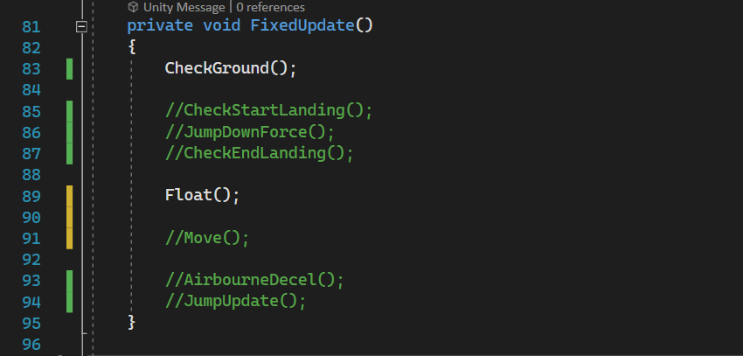
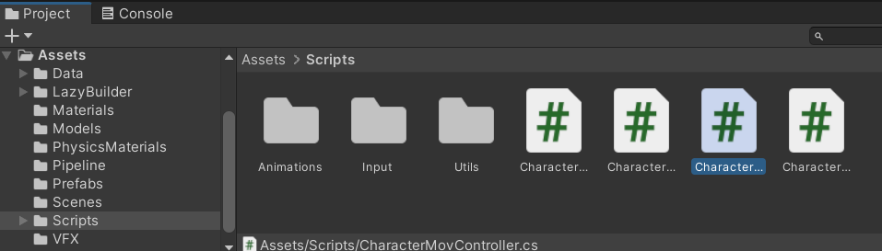

Slide 44
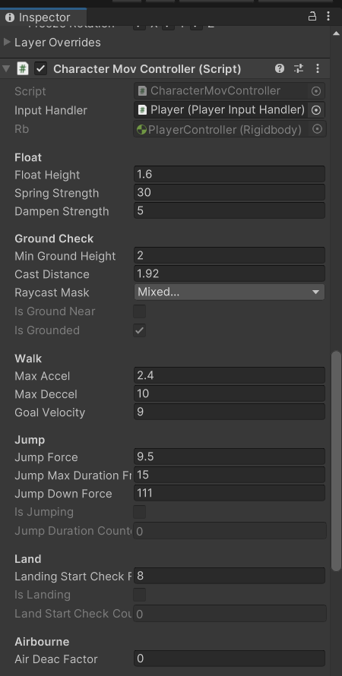
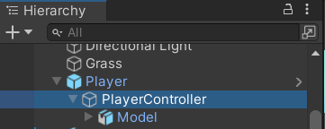
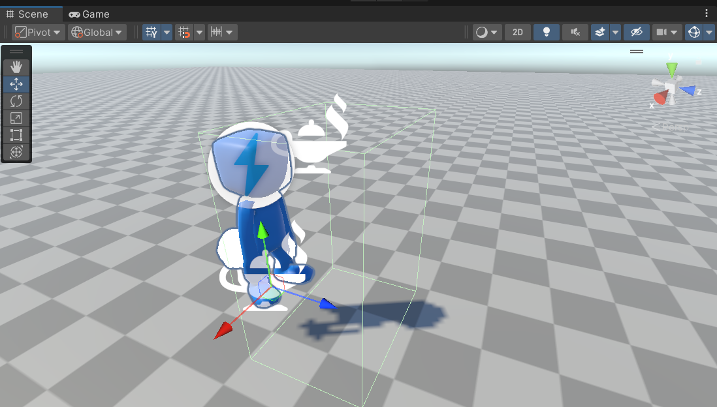

Slide 45

Character MOvement
Movin

Slide 46

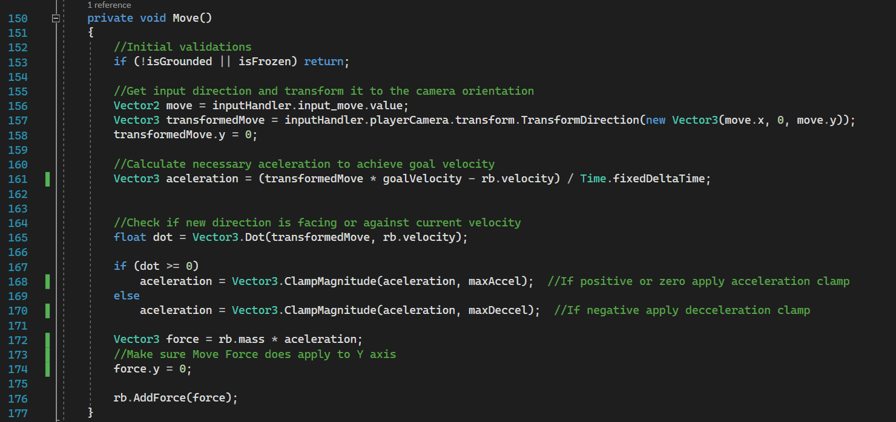

Slide 50

2nd law of Motion
F = m.a=m.(vf –vi)/t
m = mass
a = acceleration
vf = final velocity
vi = initial velocity
Newtoon
Sir Isaac Newton

Slide 53
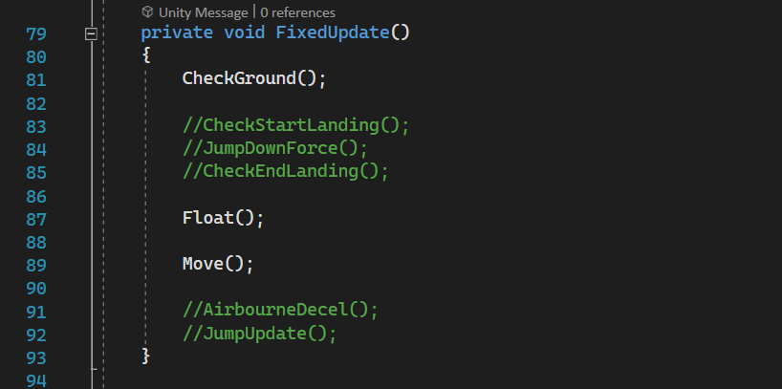

Slide 55
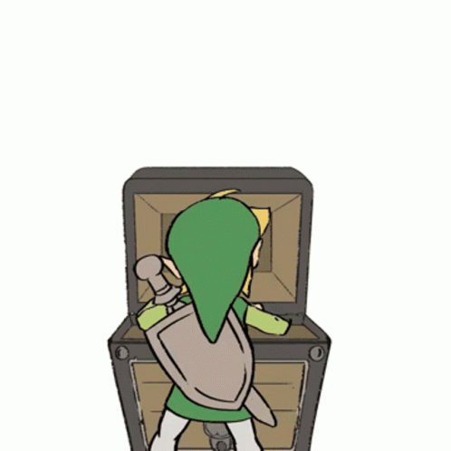
Character MOvement
Bonus stuff

Slide 56

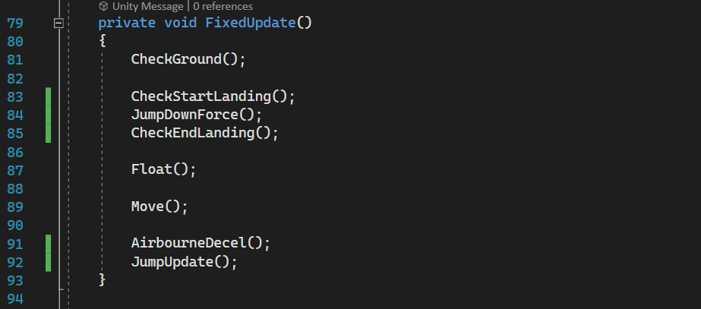

Slide 58
Level Creation
Let’s create a Simple Game with what we made so far

Slide 60
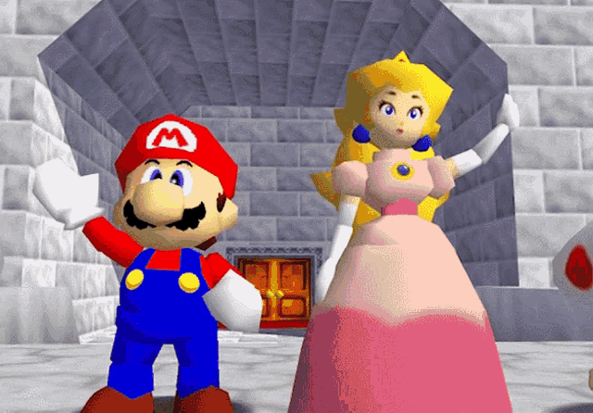
Thank you!

